Slide 1
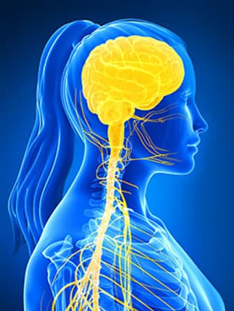
Nervous System
Organization of Nervous System: brain structure, neuron structure and function
Peripheral nervous system and its components
Communication between two neurons- neurotransmission
Different types of sensory receptors

Slide 2
Functions of Nervous system
Nervous system is responsible for our perceptions, behaviors, and memories. It initiates all voluntary movements.
Helps maintain body homeostasis along with the endocrine system

Slide 3
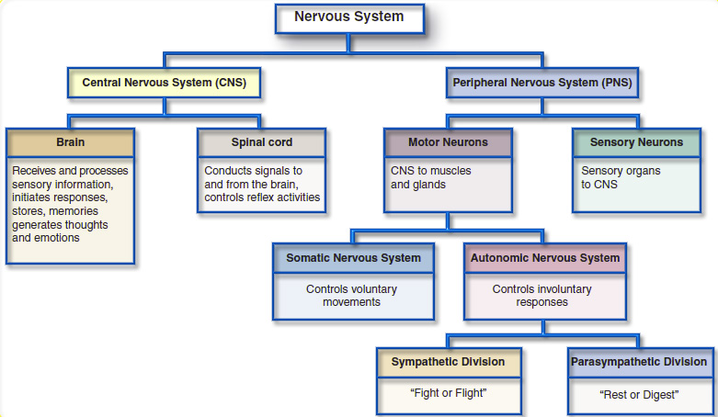
Organization of Nervous system
Central Nervous System: Processes many kinds of incoming sensory information.
Peripheral Nervous System: Includes all nervous tissue outside the CNS. Components of the PNS include nerves, ganglia, enteric plexuses and sensory receptors.

Slide 4
1. Central Nervous System: Processes many kinds of incoming sensory information.
2. Peripheral Nervous System: Includes all nervous tissue outside the CNS. Components of the PNS include nerves, ganglia, enteric plexuses and sensory receptors.
3. Somatic Nervous System:
Sensory neurons that convey information to the Central nervous system from somatic receptors in the head, body wall, and limbs and from receptors for the special senses of vision, hearing, taste, and smell.
Motor neurons that conduct nerve impulses from the CNS to skeletal muscles only. Because these motor responses can be consciously controlled, the action of this part of the PNS is voluntary.
4) Autonomic Nervous System:
sensory neurons that convey information to the CNS from autonomic sensory receptors, located primarily in visceral organs such as the stomach and lungs.
b) Motor neurons that conduct nerve impulses from the CNS to smooth muscle, cardiac muscle, and glands. Because its motor responses are not normally under conscious control, the action of the ANS is involuntary.
The motor part of ANS consists of two branches, the sympathetic division and parasympathetic division. With few exceptions, effectors receive nerves from both divisions, and usually the two divisions have opposing actions.

Slide 5
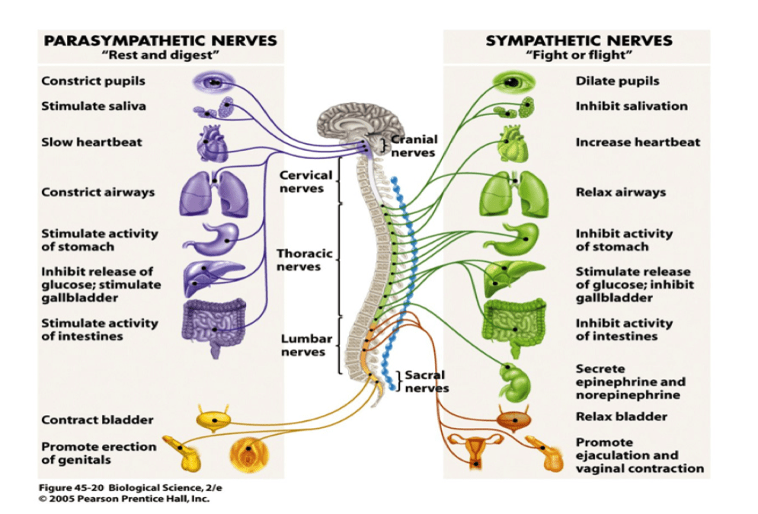

Slide 6
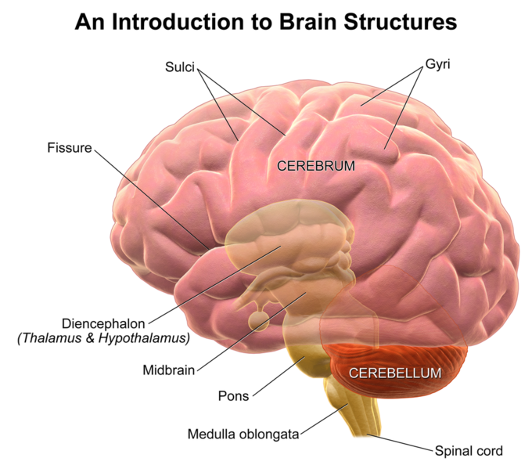
Major subdivisions of human brain
Human brain is one of the largest organs of the body, consisting of about 100 billion neurons and 10-15 trillion neuroglia with a mass of about 1300 g
Major parts of human brain:
Cerebrum
Diencephalon: Thalamus, hypothalamus and pineal gland
Cerebellum
Brain stem: Midbrain, Pons and Medulla oblongata
BRAIN STEM

Slide 7
1) Cerebrum is the largest part of the human brain. It is divided into four lobes: Occipital Lobe, Parietal Lobe, Temporal Lobe and Frontal Lobe
2) Diencephalon:
Thalamus is olive shaped structure which performs sensory functions. It directs sensory input from the eyes, ears, tongue and from other sense organs.
Hypothalamus is located below the thalamus as the name suggests. It is important in monitoring hormone concentrations, water concentrations, temperature of the body etc.
Pineal gland is about a size of small pea. It secretes the hormone melatonin, a very powerful antioxidant that promotes sleepiness, and contributes to the setting of the body’s biological clock
3) Cerebellum is involved in controlling attention, language, equilibrium, posture, etc.
4) Brain stem
Midbrain: It is a small part of the brain. It is associated with Vison, Hearing, Sleep, Arousal, Temperature etc.
Pons controls digestive and respiratory movements.
Medulla Oblongata connects skull with the spinal cord. It helps in controlling Blood Pressure, Heart Rate, Respiratory Movement, Vomiting etc.

Slide 8
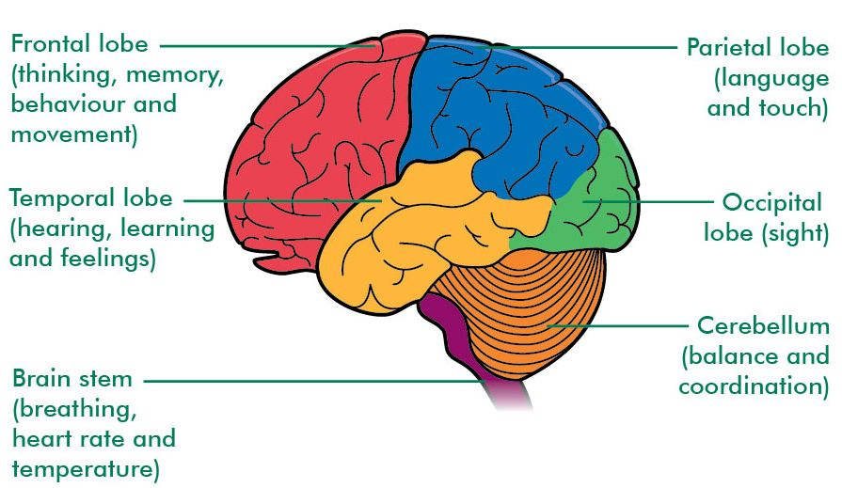
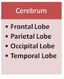
CEREBRUM is the largest part of the human brain. It is divided into four lobes:
Occipital Lobe, Parietal Lobe, Temporal Lobe and Frontal Lobe

Slide 9
Blood-brain barrier
The existence of blood-brain barrier protects brain cells from harmful substances and pathogens by preventing passage of many substances from blood into brain tissue. This barrier consists basically of very tightly sealed blood capillaries in the brain assisted by astrocytes. Lipid-soluble substances such as oxygen, carbon dioxide, alcohol, and most anesthetic agents easily cross the blood –brain barrier. Trauma, certain toxins and inflammation can cause the breakdown of blood-brain barrier.
Glucose is the main source of energy for brain cells. Because virtually no glucose is stored in the brain, the supply of glucose must be continuous. Low level of glucose in the blood supply to brain may cause mental confusion, dizziness, convulsions, and loss of consciousness.
Cerebrospinal fluid (CSF)
CSF is clear, colorless liquid that carries oxygen, glucose, and other needed chemicals from the blood to neurons and neuroglia and removes wastes and toxic substances produced by brain and spinal cord.

Slide 10
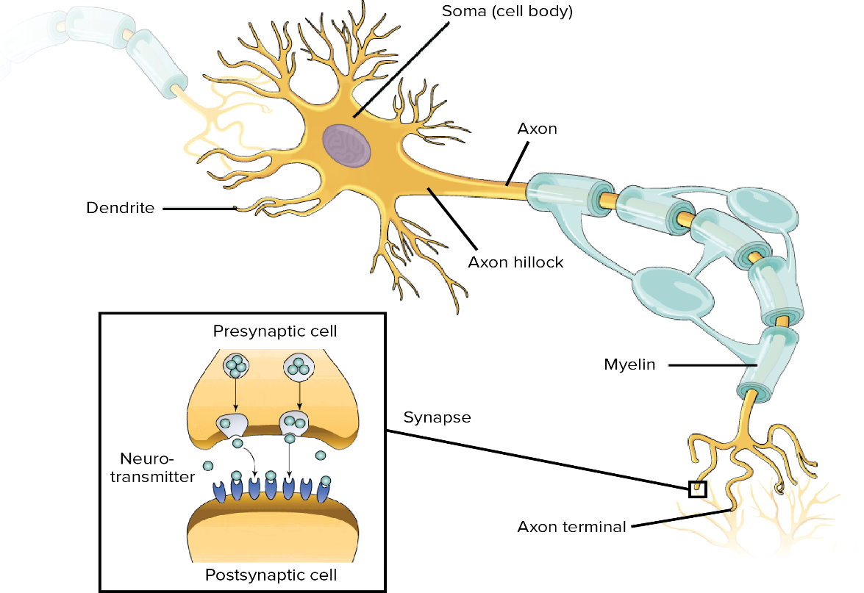
Neurons: functional unit of nervous system
The basic component of neuron are similar wherever they occur in the nervous system.
Cell body
Dendrites
Axon hillock
Axon
Synaptic knob
Axon terminal
Myelin Sheath
Nodes of Ranvier
Oligodendrocyte
Astrocyte
Nodes of Ranvier
oligodendrocytes

Slide 11
Description of a typical neuron parts
Cell body /Soma | Contains Cytoplasm with typical cell organelles and certain granules. Cell bodies from the grey matter of the nervous system. Groups of cell bodies are called nuclei in CNS and ganglia in PNS. The cell body also contains the chemical machinery to produce the neurotransmitters that the neuron uses to communicate with each other
Dendrites | Cell body plasma membrane extension into short branched fibres. Receive signals from other neurons and sensory receptors.
Axon hillock | Region of the neuron where the cell body narrows to form the axon. Nerve signals are generated here and passes down the axon.
Axon | The neuron’s largest and thinnest projection. The nerve signal travels from cell body along the axon to the synapse.
Axon terminal | End of axon which may be single or branched.
Synaptic knob | A bulb-like structure present at the end of axon terminal branches. Synaptic knob possesses synaptic vesicles containing chemicals called neurotransmitters.
Myelin sheath | Wrap-around or covering that insulates the axon and speeds signal conduction. Made by oligodendrocytes in CNS and Schwann cells in PNS. Myelinated nerve fibres are found in spinal and cranial nerves. Unmyelinated nerve fibres are found in autonomous and somatic neural systems
Nodes of Ranvier | Gaps between two adjacent myelin sheath

Slide 12
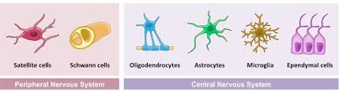
Neuroglia- cells of nervous tissues that hold them together and support neurons
Oligodendrocytes | Produce and maintain myelin sheath around several adjacent axons of CNS.
Astrocytes | Provides neuron with physical support and nourishment in CNS, help maintain the chemical environment for generation of nerve impulses, assist with growth and migration of neurons during brain development.
Microglia | Protects CNS from disease by engulfing invading microbes; migrate to areas of injured nerve tissue where they clear debris of dead cells
Ependymal cells | Form cerebrospinal fluid and assist in its circulation. Line ventricles of brain and central canal of the spinal cord
Schwann cells | Produce and maintain myelin sheath around a single axon of a PNS neuron, participate in regeneration of PNS axons
Satellite cells | Support neurons in PNS ganglia and regulate exchange of materials between neurons and interstitial fluid.

Slide 13
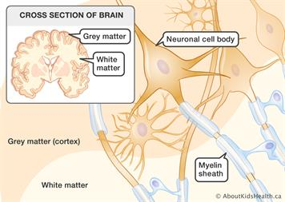
What is gray and white matter of nervous system
Gray matter of the nervous system contains neuronal cell bodies, dendrites, unmyelinated axons, axon terminals and neuroglia. There is little or no myelin in these areas.
White matter is composed primarily of myelinated axons.

Slide 14
Components of peripheral nervous system
Nerve: Nerve is a bundle of hundreds to thousands of axons plus associated connective tissue and blood vessels that is located in the PNS. 12 pairs of cranial nerves emerge from the brain and thirty-one pairs of spinal nerves emerge from the spinal cord. Each nerve follows a defined path and serves a specific region of the body.
Ganglia: small masses of nervous tissue, consisting primarily of neuron cell bodies, that are located in the PNS. Ganglia are closely associated with cranial and spinal nerves.
Enteric plexuses: are extensive networks of neurons located in the walls of organs of the gastrointestinal tract. The neurons of these plexuses help regulate the digestive system.
Sensory receptors: refers to a structure of nervous system that monitors changes in the external or internal environment.

Slide 15
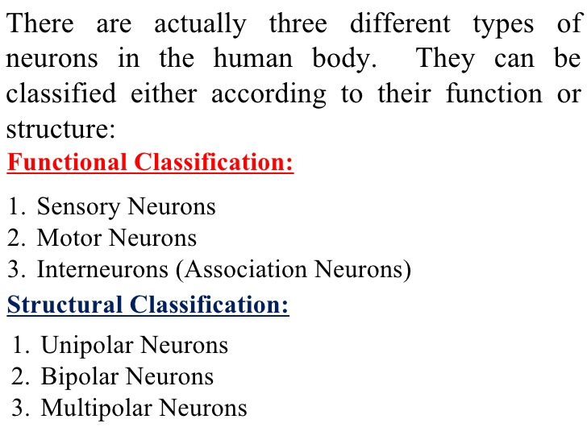
Types of neurons

Slide 16
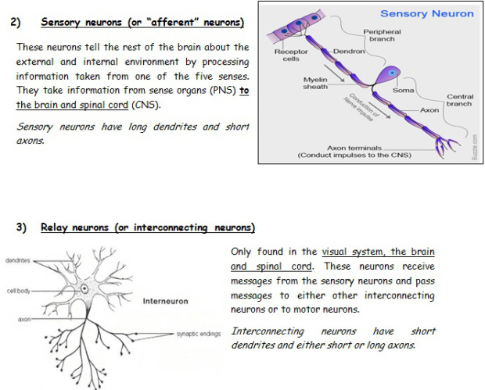
Functional classification of neurons
Functionally, neurons are classified according to the direction in which the nerve impulse is conveyed with respect to the CNS.
Sensory or Afferent neurons/nerves: The sensory neuron forms an action potential in its axon once it is activated by stimulus received by sensory receptors (of sense organs) which are located at the distal ends of sensory neurons. The action potential is conveyed into the CNS through cranial or spinal nerves. Most sensory neurons are unipolar in structure.

Slide 17
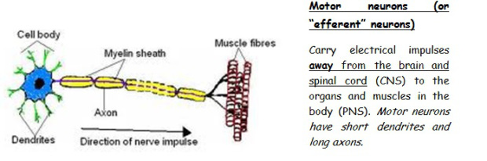
2. Motor or Efferent neurons/nerves : Convey action potentials away from the CNS to effectors (muscles and glands) in the periphery through cranial and spinal nerves. Most motor neurons are multipolar in structure.
3. Interneurons or association neurons: are located within the CNS between sensory and motor neurons. Interneurons integrate incoming sensory information from sensory neurons and then elicit a motor response by activating the appropriate motor neurons. Most interneurons are multipolar in structure.

Slide 18
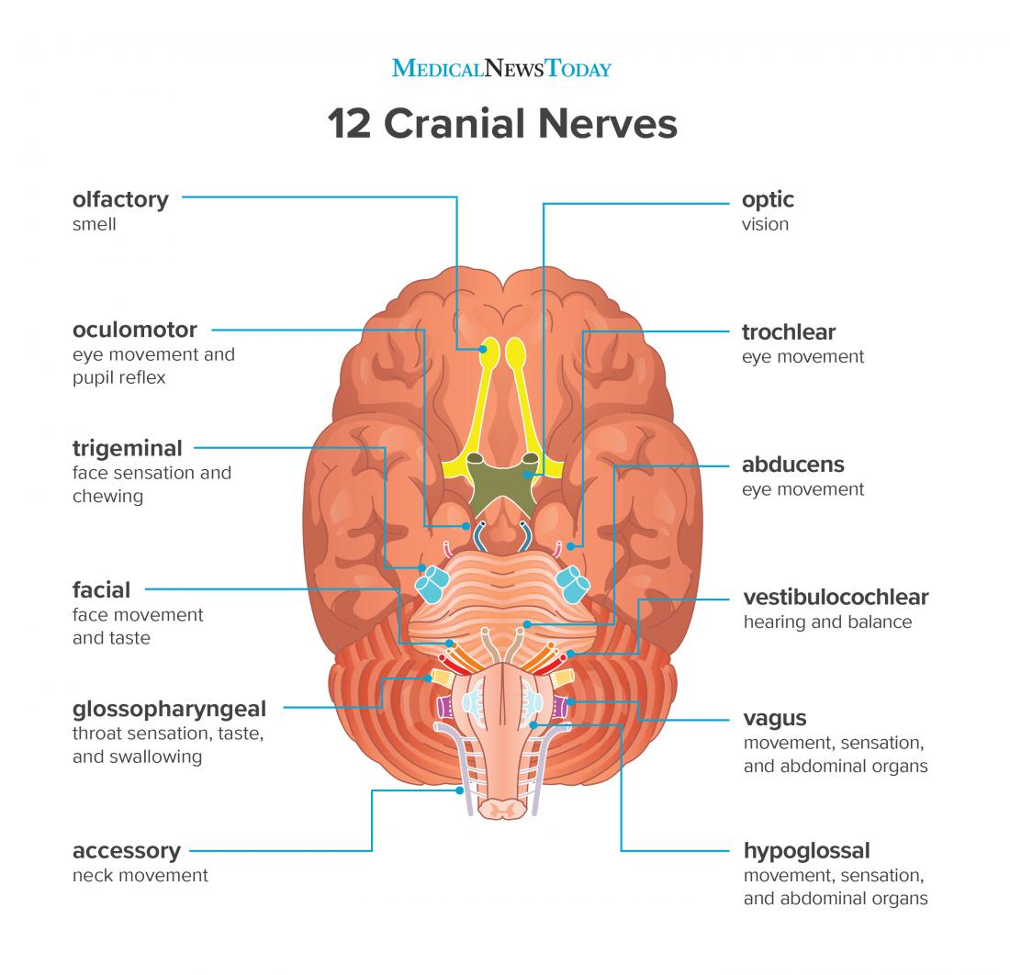
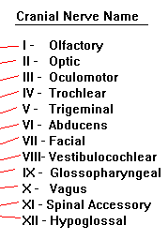
The cranial nerves are 12 pairs of nerves that can be seen on the ventral (bottom) surface of the brain. Some of these nerves bring information from the sense organs to the brain; other cranial nerves control muscles; other cranial nerves are connected to glands or internal organs such as the heart and lungs.

Slide 19
Cranial nerves
Cranial nerves |  | What type of nerve
I | Olfactory | Sensory nerve (information conveyed to CNS)
II | Optic nerve | Sensory
III | Oculomotor | Motor nerve (information from CNS to effector cells)
IV | Trochlear | Motor
V | Trigeminal | Mixed nerve (sensory and motor part)
VI | Abducens | Motor
VII | Facial | Mixed
VIII | Vestibulocochlear | Sensory
IX | Glossopharyngeal | Mixed
X | Vagus nerve | Mixed
XI | Accessory | Motor
XII | Hypoglossal | Motor

Slide 20
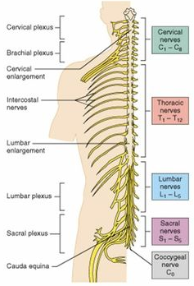
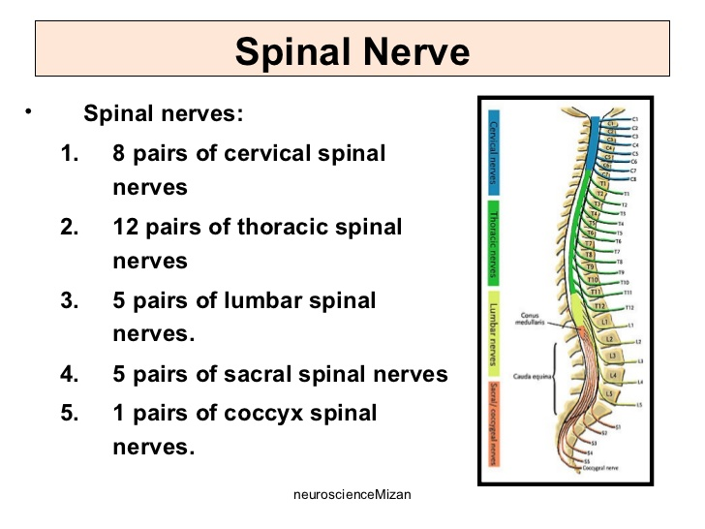
Spinal nerves
31 pair of spinal nerves forms the path of communication between spinal cord and specific body regions

Slide 21
Nerve impulse transmission in neuron
(threshold level crosses- start of depolarization of membrane)
(Peak of depolarization)
Resting potential
Depolarization
Action potential
(Neuron membrane at rest)
Refractory period
Hyperpolarization
Repolarization
(neuron comes to rest and resting potential regenerated. Ready to receive next nerve impulse)
(start of resting state of neuron)
Channels and pumps that operate during nerve impulse transmission:
1) Voltage gated –potassium channels: voltage sensor, allow passive flow of K+ ions across the axon membrane.
2) Voltage gated –Sodium channels: voltage sensor, allow passive flow of Na+ ions across the axon membrane.
3) Sodium-potassium pumps: active transporter, uses ATP to transport 3Na+ towards the outside of axon membrane and 2K+ ions are released inside the axon membrane.

Slide 22
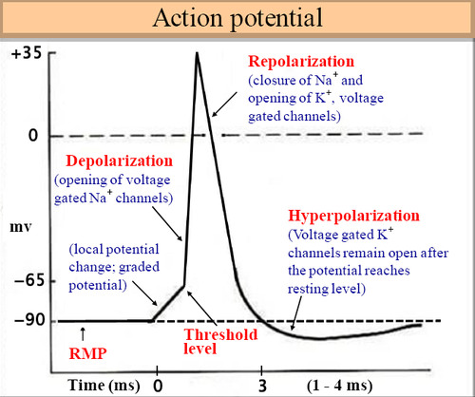
Graphical representation of nerve impulse transmission

Slide 23
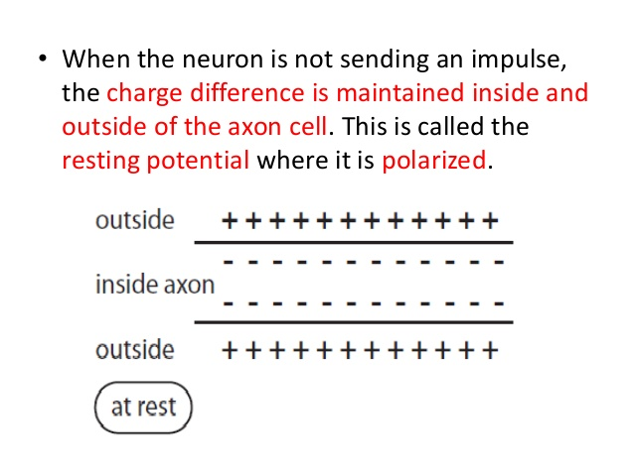
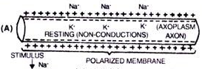
Description of the events
Polarization and resting potential- membrane is polarized due to the differential distribution of charges across the membrane. The outer side of the axonal membrane is positive and inner side of axonal membrane is negative. This is due to more sodium ions in respect to less potassium ions inside which is maintained by the sodium-potassium active pumps. This pump throws out 3Na+ from inside (axoplasm) to outside (extracellular fluid ECF) in exchange of 2K+ ions from ECF to the axoplasm. The resting membrane potential is recorded -70 to -90 millivolts (minus 70mV to 90mV). Sodium channel is closed, potassium channel is closed, and sodium-potassium pump is active.

Slide 24
2. Depolarization and action potential
After getting stimulus membrane is depolarized. That is outside of the membrane becomes negative and inside of the axon membrane becomes positive. This is due to entry of sodium ions through sodium ion channel from ECF towards axoplasm. Potassium ion channel is closed, and sodium-potassium pump is inactive.
The action potential is the state when all the sodium channels open and axonal membrane is completely at depolarized state. In other words, it is the peak of complete depolarization of the membrane that is inside positive and outside negative. Or moving depolarization is called action potential. The action potential of the membrane is recorded as +30mV.
3. Repolarization.
Following depolarization, the sodium ion channels that had been opened while the cell was undergoing depolarization, closes again. The increased positive charge within the cell now causes the potassium ion channels to open. Potassium ions (K+) begin to move down the electrochemical gradient. As potassium ion moves out of the cell the potential within the cell plummets and approaches its resting potential once more.

Slide 25
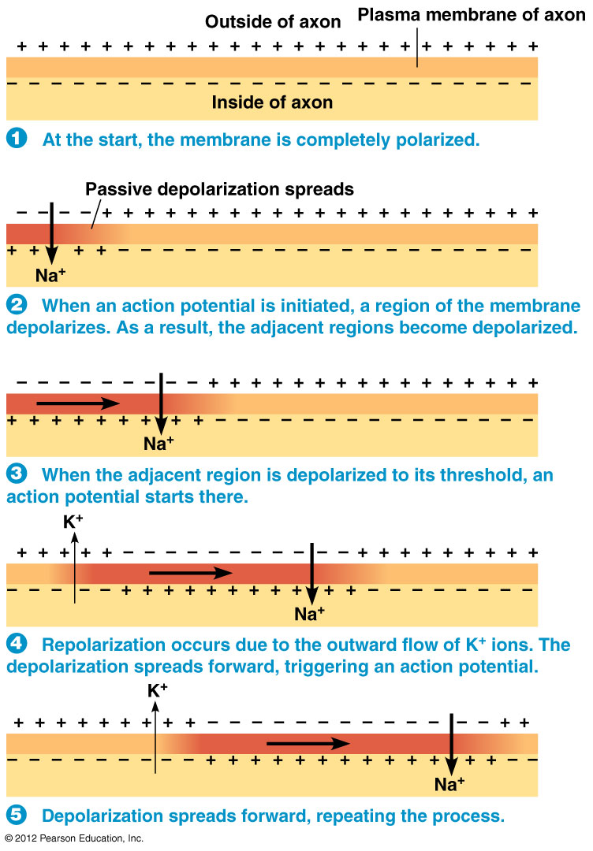

Slide 26
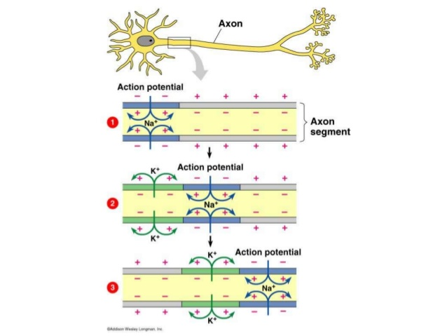
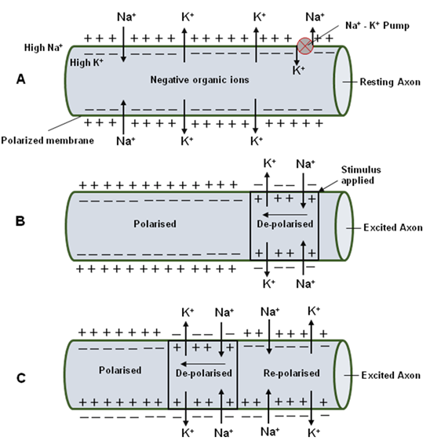

Slide 27
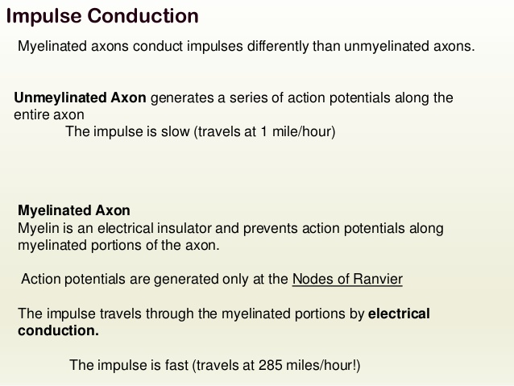
Nerve impulse conduction in myelinated and non-myelinated nerve fibres

Slide 28
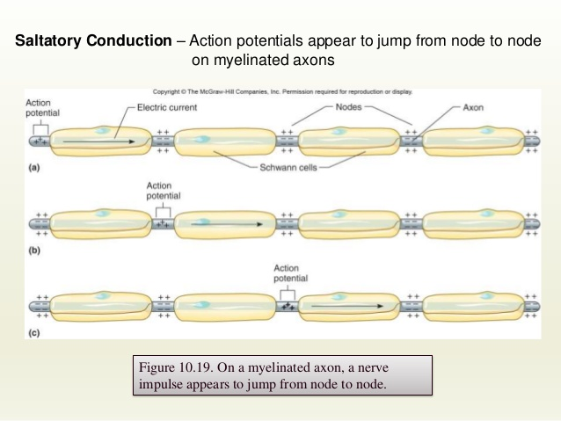
Nerve impulse conduction in myelinated nerve fibres: Saltatory conduction

Slide 29
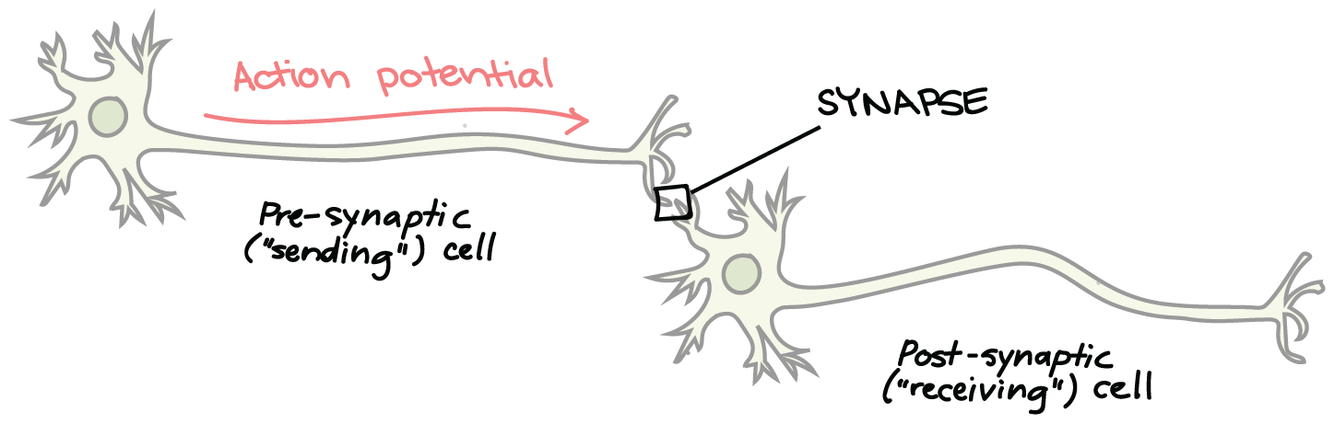
Communication between two neurons- Synaptic Neurotransmission
How do neurons "talk" to one another?
The action happens at the synapse, the point of communication between two neurons or between a neuron and a target cell, like a muscle or a gland. At the synapse, the firing of an action potential in one neuron—the presynaptic, or sending neuron—causes the transmission of a signal to another neuron—the postsynaptic, or receiving neuron—making the postsynaptic neuron either more or less likely to fire its own action potential.

Slide 30
What are the two types of synapse?
Electrical synapse
Chemical synapse
At electrical synapses, there is a direct physical connection between the presynaptic neuron and the postsynaptic neuron through gap junctions and allows ions to flow directly from one cell into another. Gap junctions are found in Visceral smooth muscle, cardiac muscle, and the brain. Advantages of electrical synapse is rapid conduction and coordination.
At chemical synapses, there is release of neurotransmitters (chemicals) in synaptic clefts (a tiny space filled with interstitial fluid) when action potentials reaches the axon terminals at presynaptic neuron . Neurotransmitters are stored in the synaptic vesicles, and upon release into the clefts, they binds to postsynaptic neuron and depolarizes to generate next action potential at postsynaptic cell.

Slide 31
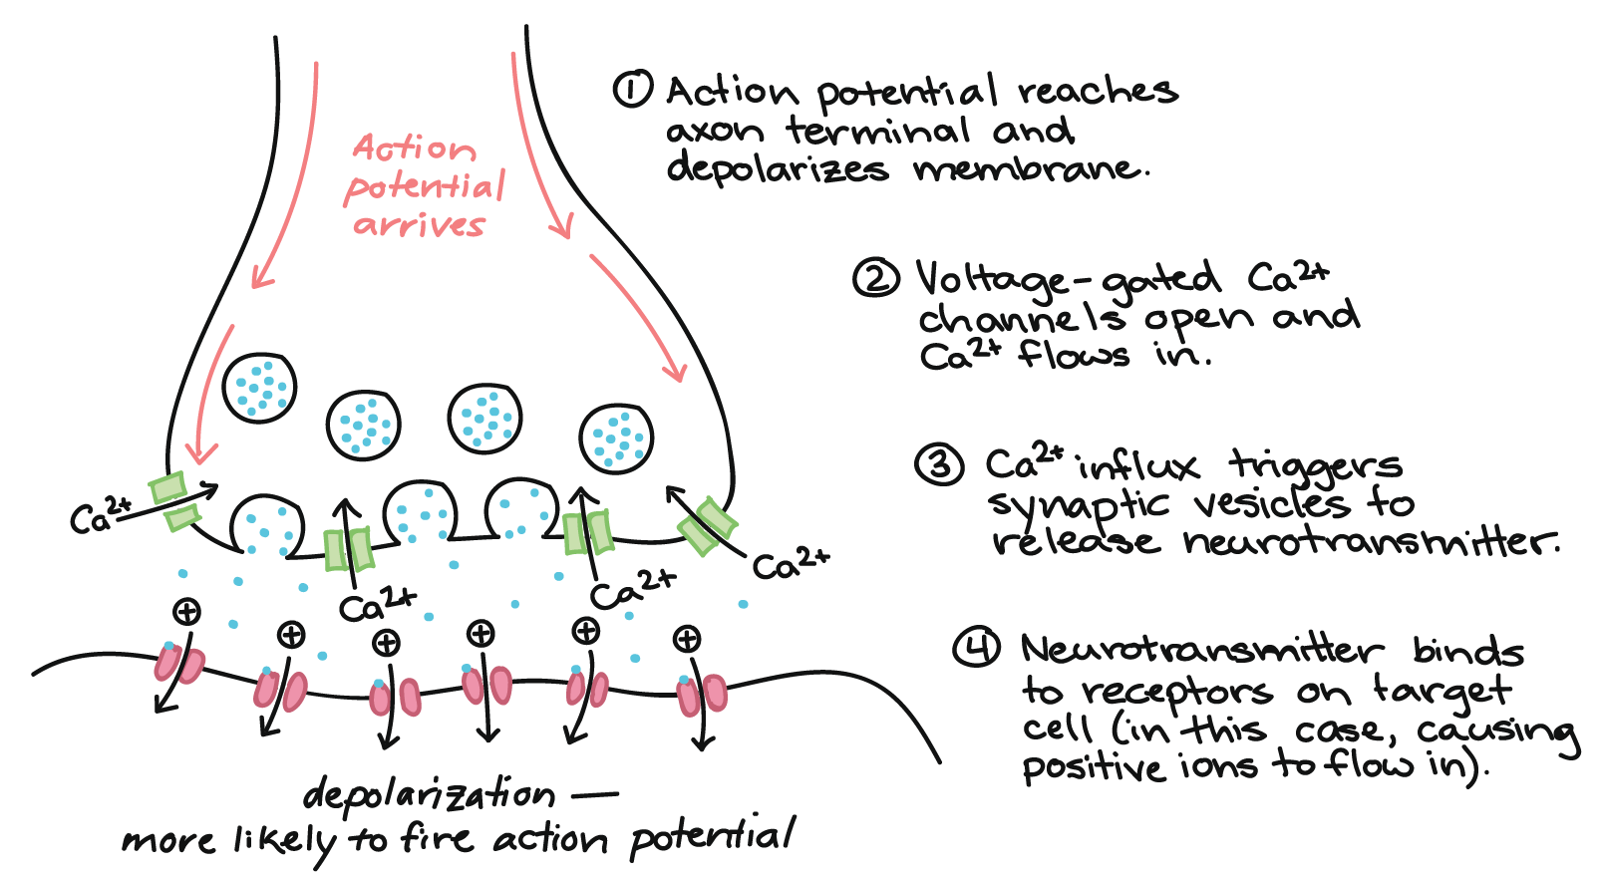
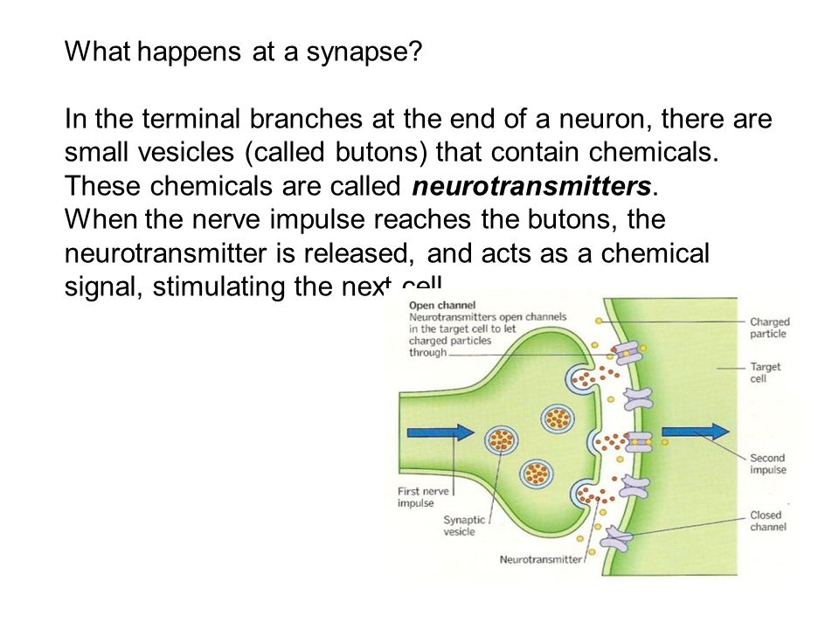
What events occurs at Chemical synapse?

Slide 32
Examples of neurotransmitters
Acetylcholine- in neuromuscular junction
Amino acids glutamate and aspartate- in CNS, having excitatory effects
Amino acids gamma aminobutyric acid (GABA) and glycine
Modified Amino acids such as norepinephrine, dopamine, serotonin. Dopamine are active during emotional responses, addictive behaviours and pleasurable experiences. Serotonin in controlling mood, onset of sleep
Neuropeptides such as endorphins are body’s natural pain killers

Slide 33
